Slide 1
A presentation on binary tree
Name: Sagor Ray
ID: 20191135010
Sec: D

Slide 2
INTRODUCTION
The binary tree is a fundamental structure in mathematics and computer science. Some of the terminology of rooted trees, such as, edge, path, branch, leaf, depth, and level number, will also be used for binary trees. However, we will use the term node, rather than vertex, with binary trees. We emphasize that a binary tree is not a special case of a rooted tree; they are different mathematical objects.

Slide 3
Binary tree
A binary tree T is defined as a finite set of elements, called nodes, such that:
(1) T is empty (called the null tree or empty tree), or
(2) T contains a distinguished node R, called the root of T , and the remaining nodes of T form an ordered pair of disjoint binary trees T1 and T2.
If T does contain a root R, then the two trees T1 and T2 are called, respectively, the left and right subtrees of R. If T1 is nonempty, then its root is called the left successor of R; similarly, if T2 is nonempty, then its root is called the right successor of R.
The above definition of a binary tree T is recursive since T is defined in terms of the binary subtrees T1 and T2. This means, in particular, that every node N of T contains a left and a right subtree, and either subtree or both subtrees may be empty. Thus every node N in T has 0, 1, or 2 successors. A node with no successors is called a terminal node. Thus both subtrees of a terminal node are empty

Slide 4

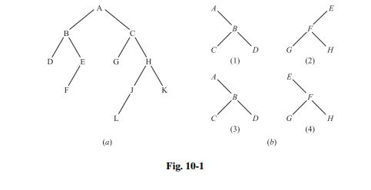
Example of binary tree
Accordingly, in Fig. 10-1(a):
(a) B is a left successor and C is a right successor of the root A.
(b) The left subtree of the root A consists of the nodes B, D, E, and F, and the right subtree of A consists of the nodes C, G, H, J, K, and L.
(c) The nodes A, B, C, and H have two successors, the nodes E and J have only one successor, and the nodes D, F , G, L, and K have no successors, i.e., they are terminal nodes.

Slide 5
What is terminology?
Terminology describing family relationships is frequently used to describe relationships between the nodes of a tree T . Specifically, suppose N is a node in T with left successor S1 and right successor S2. Then N is called the parent (or father) of S1 and S2. Analogously, S1 is called the left child (or left son) of N, and S2 is called the right child (or right son) of N. Furthermore, S1 and S2 are said to be siblings (or brothers). Every node N in a binary tree T , except the root, has a unique parent, called the predecessor of N. The terms descendant and ancestor have their usual meaning. That is, a node L is called a descendant of a node N (and N is called an ancestor of L) if there is a succession of children from N to L. In particular, L is called a left or right descendant of N according to whether L belongs to the left or right subtree of N. Terminology from graph theory and horticulture are also used with a binary tree T . Specifically, the line drawn from a node N of T to a successor is called an edge, and a sequence of consecutive edges is called a path. A terminal node is called a leaf, and a path ending in a leaf is called a branch.

Slide 6

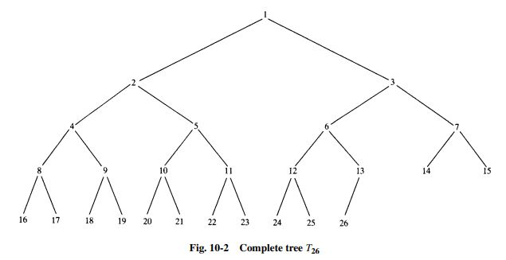
Complete binary tree
Consider any binary tree T . Each node of T can have at most two children. Accordingly, one can show that level r of T can have at most 2r nodes. The tree T is said to be complete if all its levels, except possibly the last, have the maximum number of possible nodes, and if all the nodes at the last level appear as far left as possible. Thus there is a unique complete tree Tn with exactly n nodes (where we ignore the contents of the nodes). The complete tree T26 with 26 nodes appears in Fig. 10-2.

Slide 7
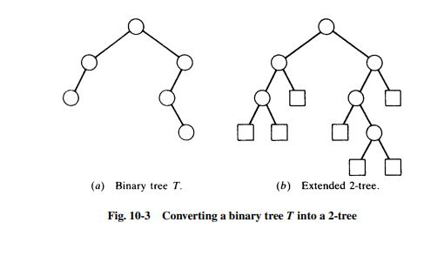
Extended binary tree
The term “extended binary tree” comes from the following operation. Consider any binary tree T , such as the tree in Fig. 10-3(a). Then T may be “converted” into a 2-tree by replacing each empty subtree by a new node, as pictured in Fig. 10-3(b). Observe that the new tree is, indeed, a 2-tree. Furthermore, the nodes in the original tree T are now the internal nodes in the extended tree, and the new nodes are the external nodes in the extended tree. We note that if a 2-tree has n internal nodes, then it will have n + 1 external nodes.

Slide 8
REPRESENTING BINARY TREES IN MEMORY
Consider a binary tree T . Unless otherwise stated or implied, T will be maintained in memory by means of a linked representation which uses three parallel arrays, INFO, LEFT, and RIGHT, and a pointer variable ROOT as follows. First of all, each node N of T will correspond to a location K such that: (1) INFO[K] contains the data at the node N. (2) LEFT[K] contains the location of the left child of node N. (3) RIGHT[K] contains the location of the right child of node N. Furthermore, ROOT will contain the location of the root R of T . If any subtree is empty, then the corresponding pointer will contain the null value; if the tree T itself is empty, then ROOT will contain the null value
Remark 1: Most of our examples will show a single item of information at each node N of a binary tree T . In actual practice, an entire record may be stored at the node N. In other words, INFO may actually be a linear array of records or a collection of parallel arrays.
Remark 2: Any invalid address may be chosen for the null pointer denoted by NULL. In actual practice, 0 or a negative number is used for NULL.

Slide 9
TRAVERSING BINARY TREES
There are three standard ways of traversing a binary tree T with root R. These three algorithms, called preorder, inorder, and postorder, are as follows:
Preorder: (1) Process the root R. (2) Traverse the left subtree of R in preorder. (3) Traverse the right subtree of R in preorder. Inorder: (1) Traverse the left subtree of R in inorder. (2) Process the root R. (3) Traverse the right subtree of R in inorder.
Postorder: (1) Traverse the left subtree of R in postorder. (2) Traverse the right subtree of R in postorder. (3) Process the root R.

Slide 10
BINARY SEARCH TREES
This section discusses one of the most important data structures in computer science, a binary search tree. This structure enables us to search for and find an element with an average running time f (n) = 0(log2 n), where n is the number of data items. It also enables us to easily insert and delete elements. This structure contrasts with the following structures:
(a) Sorted linear array: Here one can search for and find an element with running time f (n) = 0(log2 n). However, inserting and deleting elements is expensive since, on the average, it involves moving 0(n) elements.
(b) Linked list: Here one can easily insert and delete elements. However, it is expensive to search and find an element, since one must use a linear search with running time f (n) = 0(n). Although each node in a binary search tree may contain an entire record of data, the definition of the tree depends on a given field whose values are distinct and may be ordered.

Slide 11
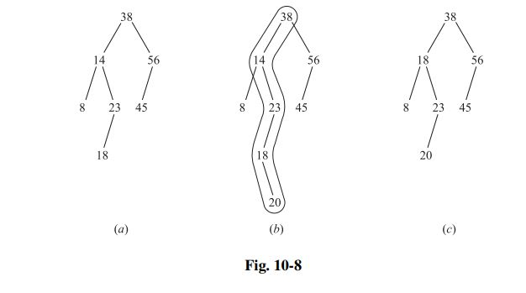
example
The binary tree T in Fig. 10-8(a) is a binary search tree. That is, every node N in T exceeds every number in its left subtree and is less than every number in its right subtree. Suppose the 23 were replaced by 35. Then T would still be a binary search tree. On the other hand, suppose the 23 were replaced by 40. Then T would not be a binary search tree, since 40 would be in the left subtree of 38 but 40 > 38.

Slide 12
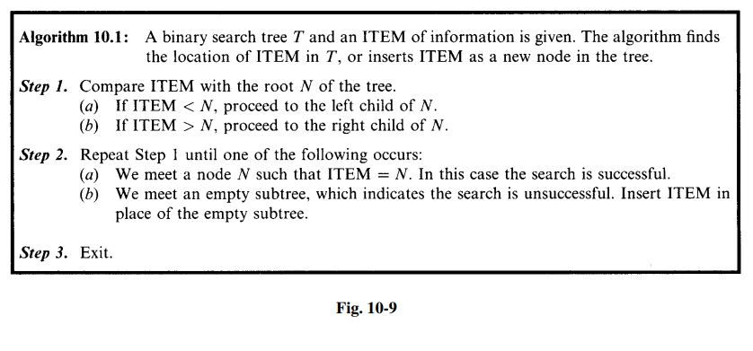
Searching and Inserting in a Binary Search Tree A search and insertion algorithm in a binary search tree T appears in Fig. 10-9.

Slide 13
PRIORITY QUEUES, HEAPS
Let S be a priority queue. That is, S is a set where elements may be periodically inserted and deleted, but where the current largest element (element with highest priority) is always deleted. One may maintain S in memory as follows: (a) Linear array: Here one can easily insert an element by simply adding it to the end of the array. However, it is expensive to search for and find the largest element, since one must use a linear search with running time f (n) = 0(n). (b) Sorted linear array: Here the largest element is either first or last, and so it is easily deleted. However, inserting and deleting elements is expensive since, on the average, it involves moving 0(n) elements. This section introduces a discrete structure which can efficiently implement a priority queue S.
Heaps Suppose H is a complete binary tree with n elements. We assume H is maintained in memory using its sequential representation, not a linked representation.

Slide 14
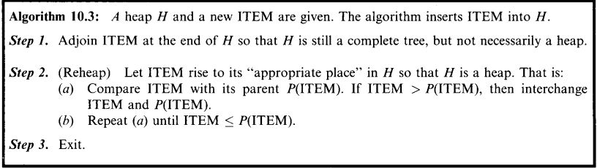
Complexity of the Heap Algorithms
Let H be a heap with n nodes. Since H is a complete tree, d ≈ log2 n where d is the depth of H.Algorithm 10.3 tells us to let the new ITEM proceed up the tree, from level to level, until finding its appropriate place in H. Algorithm 10.4 tells us to let the original last node L proceed down the tree, level by level, until finding its appropriate place in H. In either case, the number of moves cannot exceed the depth d of H. Thus the running time f (n) of either algorithm is very fast; specifically, f (n) = 0(log2 n). Accordingly, the heap is a much more efficient way to implement a priority queue S than either the linear array or sorted linear array mentioned at the beginning of the section.

Slide 15
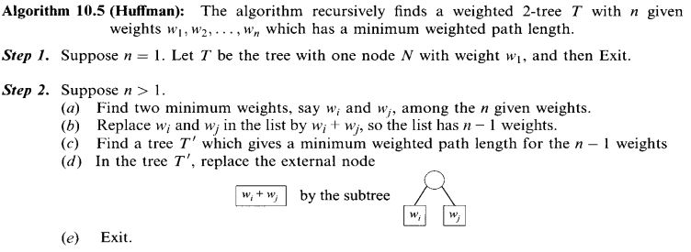
Huffman’s Algorithm
The general problem we want to solve is the following. Suppose a list of n weights is given: W1, W2,...,Wn Among all the 2-trees with n external nodes and with the given n weights, find a tree T with a minimum weighted path length. (Such a tree T is seldom unique.) Huffman gave an algorithm to find such a tree T . Huffman’s algorithm, which appears in Fig. 10-17, is recursively defined in terms of the number n of weights. In practice, we use an equivalent iterated form of the Huffman algorithm which constructs the desired tree T from the bottom up rather than from the top down.

Slide 16
Huffman coding algorithm
Huffman coding is a lossless data compression algorithm. In this algorithm, a variable-length code is assigned to input different characters. The code length is related to how frequently characters are used. Most frequent characters have the smallest codes and longer codes for least frequent characters.
There are mainly two parts. First one to create a Huffman tree, and another one to traverse the tree to find codes.
For an example, consider some strings “YYYZXXYYX”, the frequency of character Y is larger than X and the character Z has the least frequency. So the length of the code for Y is smaller than X, and code for X will be smaller than Z.

Slide 17
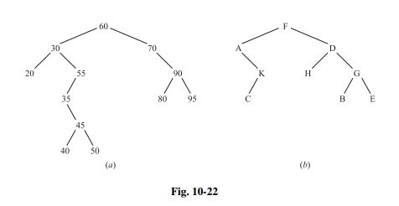
Problem
Consider the binary tree T in Fig. 10-22(b) (a) Find the depth d of T . (b) Traverse T using the preorder algorithm. (c) Traverse T using the inorder algorithm. (d) Traverse T using the postorder algorithm. (e) Find the terminal nodes of T, and the order they are traversed in (b), (c), and (d).

Slide 18
solution
(a) The depth d is the number of nodes in a longest branch of T ; hence d = 4.
(b) The preorder traversal of T is a recursive NLR algorithm, that is, it first processes a node N, then its left subtree L, and finally its right subtree R. Letting [A1,...,Ak ] denote a subtree with nodes A1,...,Ak , the tree T is traversed as follows: F −[A, K, C][D, H, G, B, E] or F −A−[K,C]−D−[H][G, B, E]
or, finally, F −A−K−C−D−H −G−B−E

Slide 19
(c) The inorder traversal of T is a recursive LNR algorithm, that is, it first processes a left subtree L, then its node N, and finally its right subtree R. Thus T is traversed as follows: [A, K, C]−F −[D, H, G, B, E] or A−[K,C]−F −[H]−D−[G, B, E] or finally, A−K−C−F −H −D−B−G−E
(d) The postorder traversal of T is a recursive LRN algorithm, that is, it first processes a left subtree L, then its right subtree R, and finally its node N. Thus T is traversed as follows: [A, K, C][D, H, G, B, E]−F or [K,C]−A−[H][G, B, E]−D−F or, finally, C−K−A−H −B−E−G−D−F

Slide 20
(e) The terminal nodes are the nodes without children. They are traversed in the same order in all three traversal algorithms: C, H, B, E

Slide 21
The end
Thank you

